Slide 1
SOEN 343
Week 5b MVC model and the observer pattern
Dr. Morales

Slide 2
Learning objectives
Understand MVC model
Identify the differences between MVC-I and MVC-II models
Analyze the relationship between MVC model and observer pattern
Evaluate in which situations is appropriate to apply the observer pattern

Slide 3
Model-View-Controller (MVC) model
It belongs to the interaction-oriented family of software architecture styles, along with PAC
MVC was first introduced by Reenskaug at the Xerox Palo Alto Research Center in 1979
Model-View-Controller programming is the application of this three-way factoring whereby objects of different classes take over the operations related to the application domain (the model), the display of the application's state (the view), and the user interaction with the model and the view (the controller)

Slide 4
MVC: model
Model:
Manages the behavior and data of the application domain
Responds to requests for information about its state (usually from the view)
Responds to instructions to change state (usually from the controller)
In event-driven systems, the model notifies observers (usually views) when the information changes so that they can react. (see observer pattern)
In enterprise software, a model often serves as a software approximation of a real-world process
In a game, the model is represented by the classes defining the game entities, which are embedding their own state and actions

Slide 5
MVC: view
Renders the model into a form suitable for visualization or interaction, typically a user interface element
Multiple views can exist for a single model element for different purposes
The view renders the contents of a portion of the model’s data
If the model data changes, the view must update its presentation as needed. This can be achieved by using:
a push model, in which the view registers itself with the model for change notifications. (see the observer pattern)
a pull model, in which the view is responsible for calling the model when it needs to retrieve the most current data

Slide 6
MVC: controller
Receives user input and initiates a response by making calls on appropriate model objects.
Accepts input (e.g. events or data) from the user and instructs the model to perform actions based on that input.
The controller translates the user's interactions with the view it is associated with, into actions that the model will perform that may use some additional/changed data gathered in a user-interactive view.
A controller may also spawn new views upon user demand.

Slide 7
MVC: interactions
The model objects are created.
Each model object represents a portion of the business model state held by the application.
The views register as observers on the model objects.
Any changes to the underlying data of the model objects immediately result in a broadcast change notification, which all associated views receive (in the push model)
Note that the model is not aware of the view or the controller -- it simply broadcasts change notifications to all registered observers
The controller is bound to a view
It can then react to any user interaction provided by this view.
Any user actions that are performed on the view will invoke a method in the controller class
The controller is given a reference to the underlying model.
It can then trigger the model’s behavior functions and/or state change when one of its methods is called

Slide 8
Once a user interacts with the view…
The view recognizes that a GUI action -- for example, pushing a button or dragging a scroll bar -- has occurred, e.g., using a listener method that is registered to be called when such an action occurs. The mechanism varies depending on the technology or library used
In the listener method, the view calls the appropriate method in the controller
The controller translates this signal into an appropriate action in the model, which will in turn possibly be updated in a way appropriate to the user's action
If the state of some of the model’s elements have been altered, they then notify registered observers of the change. In some architectures, the controller may also be responsible for updating the view. Again, technical details may vary according to technology or library used

Slide 9
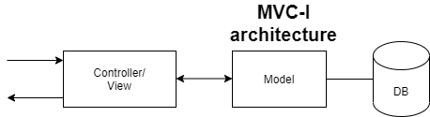
MVC-I
The MVC-I is a simple version of MVC architecture where the system is simply decomposed into two sub-systems: The Controller-View and the Model
Basically, the Controller-View takes care of input and output processing and their interfaces; the Model module copes with all core functionality and the data
The Controller-View module registers with (attaches to) the Model module

Slide 10
MVC-I contd.
The Model module notifies the Controller-View module of any data changes so that any graphics data display will be changed accordingly; the controller also takes appropriate action upon the changes
The connection between the Controller-View and the Model can be designed in a pattern of subscribe-notify (observer pattern) whereby the Controller-View subscribes to the Model and the Model notifies the Controller-View of any changes
In other words, the Controller-View is an observer of the data in the Model module.

Slide 11
MVC-II
It is a further development from the MVC-I architecture
The View module and the Controller module are separate; this allows for the division of labor as for example, programming experts can work on the development of Controller while Graphics interface design experts can work on the development of View
The View module displays the data while the Controller module takes input requests, validates input data, initiates the Model and the View and their connection, and dispatches tasks
The Controller and the View register with the Model
Whenever the data in the Model is changed the View module and the Controller are notified of the changes
Because graphics interface technology is updated rapidly and business requirements are changed very often, it is much better to keep the View separated from the Controller

Slide 12
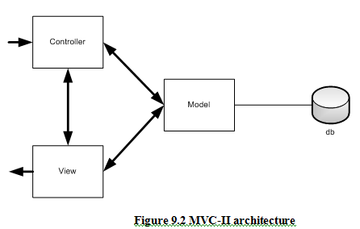
MVC-II architecture
Notes:
The MVC II architecture is the same as MVC-I in in slide 8, except that the controller and the view are separated.

Slide 13
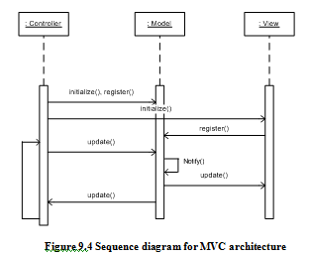
SD for a generic MVC architecture
Notes:
After clients start up the MVC application, the controller initializes the Model and View, and attaches the View and itself to the Model (this is called registration with the Model.
Later, the Controller intercepts a user request either directly from command line or through the View interface, and forwards the request to the Model to update the data in the Model.
The changes in the Model will trigger the Model to notify all attached or registered listeners of all changes, and the interface in the View will also be updated right way.

Slide 14
Applicable domain of MVC architecture:
Suitable for interactive applications where multiple views are needed for a single data model and the interfaces are prone to data changes frequently
Suitable for applications where there are clear divisions between controller, view, and data modules so that different professionals can be assigned to work on different aspects of such applications concurrently

Slide 15
Benefits:
There are many MVC vendor framework toolkits available
Multiple views synchronized with same data model
Easy to plug-in new or change interface views, thus allowing updating the interface views with new technologies without overhang the rest of the system
Very effective for developments if graphics expertise professionals, programming professionals, and database development professionals are working in a team in a designed project

Slide 16


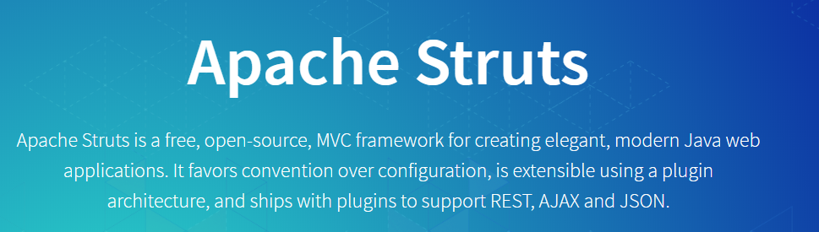


Examples of MVC frameworks

Slide 17
Limitations:
Multiple pairs of controllers and views based on the same data model make any data model change expensive
The division between the View and the Controller is not clear in some cases
Does not fit well agent-oriented applications such robotics applications or air traffic control system. For that type of systems, PAC (presentation, abstraction and control) architecture is good substitute

Slide 18
Observer pattern

Slide 19
Observer pattern motivation and intent
Motivation
The cases when certain objects need to be informed about the changes occurring in other objects are frequent. To have a good design means to decouple as much as possible and to reduce the dependencies. The observer pattern can be used whenever a subject has to be observed by one or more observers
Intent
Define a one-to-many dependency between objects so that when one object changes state, all its dependents are notified and updated automatically
This pattern is a cornerstone of the Model-View-Controller architectural design, where the Model implements the business logic of the program, and the Views are implemented as Observers that are as much uncoupled as possible from the Model components

Slide 20
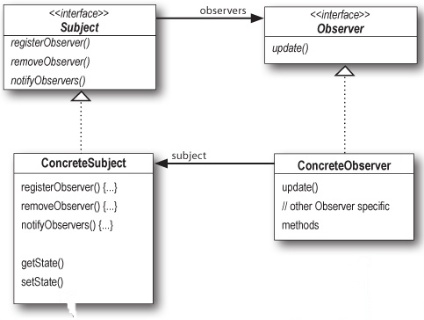
Observer design pattern UML diagram

Slide 21
Participant classes in the observer pattern
Subject. Interface or abstract class defining the operations for attaching and de-attaching observers to the client. It is often referred to as “Observable”
ConcreteSubject -. Concrete class that maintains the state of the observed object and when a change in its state occurs it notifies the attached Observers. If used as part of MVC, the ConcreteSubject classes are the Model classes that have Views attached to them.
Observer. Interface or abstract class defining the operations to be used to notify the registered Observer objects.
ConcreteObserver. Concrete observer subclasses that are attached to a particular Subject class. There may be different concrete observers attached to a single Subject that will provide a different view of that Subject

Slide 22
Design principle: program to an interface
Observable Interface
Observer interface
public interface Observable {
public void attachObserver(Observer o);
public void detachObserver(Observer o);
public void notifyObservers(Observable observable);
}
public interface Observer {
public void update(Observable o);
}

Slide 23
Observer pattern: behavior
The client class instantiates the ConcreteObservable object.
Then it instantiates and attaches the concrete observers to it using the methods defined in the Observable interface
Each time the (observable) state of the subject is changing, it notifies all the attached Observers using the methods defined in the Observer interface
When a new Observer is added to the application, all we need to do is to instantiate it in the client class and to add attach it to the Observable object
The classes already created will remain unchanged

Slide 24
Observer pattern: implementation
class ClockTimerModel implements Observable {
public
int GetHour(){return hour;}
int GetMinute(){return minute;}
int GetSecond(){return second;}
void tick(){
// update internal state
second ++;
if (second >= 60){
minute++;
second = 0;
if (minute >=60){
hour++;
minute=0;
if (hour >= 24){
hour=0;
}
}
}
// specify that my state was changed
// notify all attached Observers of a change
notifyObservers(this);
}
void start(int secs){
for (int i = 1; i <= secs; i++)
tick();
}
private
int hour; int minute; int second;
List<Observer> observers = new ArrayList<Observer>();
Model classes need to implement an Observable interface
When a part of their state that is observed is changed, call notifyObservers() method that will notify all the attached observers by calling their update() method
@Override
public void attachObserver(Observer o) {
this.observers.add(o);
}
@Override
public void detachObserver(Observer o) {
this.observers.remove(o);
}
@Override
public void notifyObservers(Observable observable) {
for (Observer observer : observers) {
observer.update(observable);
}
}

Slide 25
Observer pattern: implementation
View classes implement an Observer interface
They need to implement the update() method that is called by the notifyObservers()method of the Observable class
This method does the necessary updates to the view offered to the user (here a simple console output)
class DigitalClockView implements Observer {
public
void update(Observable obs) {
//redraw my clock’s reading after I was notified
int hour = ((ClockTimerModel) obs).GetHour();
int minute = ((ClockTimerModel) obs).GetMinute();
int second = ((ClockTimerModel) obs).GetSecond();
System.out.println(hour+":"+minute+":"+second);
}
}

Slide 26
Observer pattern: implementation
import java.util.Scanner;
public class ObserverDemo extends Object {
DigitalClockView clockView;
ClockTimerModel clockModel;
public ObserverDemo() {
//create the View object
clockView = new DigitalClockView();
//create the Model object
clockModel = new ClockTimerModel();
//connect the View object to the Model object
clockModel.attach(clockView);
}
public static void main(String[] av) {
ObserverDemo od = new ObserverDemo();
od.demo();
}
public void demo() {
System.out.println("Enter the number of seconds to run the clock ");
Scanner kbd = new Scanner(System.in);
int secs = kbd.nextInt();
clockModel.start(secs);
kbd.close();
}
}
The main program must:
Create the Model object
Create the View object
Connect the View object to the Model object
Then, any change in the state of the Model object triggers the update of the Views attached to it

Slide 27
Summary

Slide 28
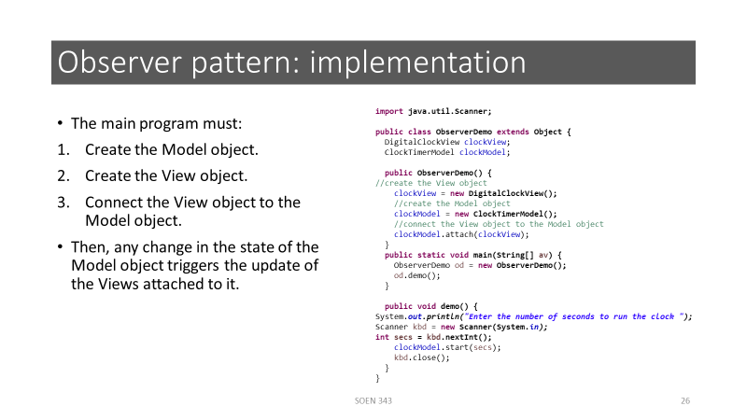

Slide 29
References
OODesign.com. Observer Pattern.
Erich Gamma, Richard Helm, Ralph Johnson and John Vlissides, Design Patterns – Elements of Reusable Object-Oriented Software, Addison-Wesley, 1995.
Eric Freeman; Elisabeth Robson; Head First Design Patterns. by O'Reilly Media, Inc., 2004
Source code clockTimer

